Slide 1
Newton’s Law of Universal Gravitation

Slide 2
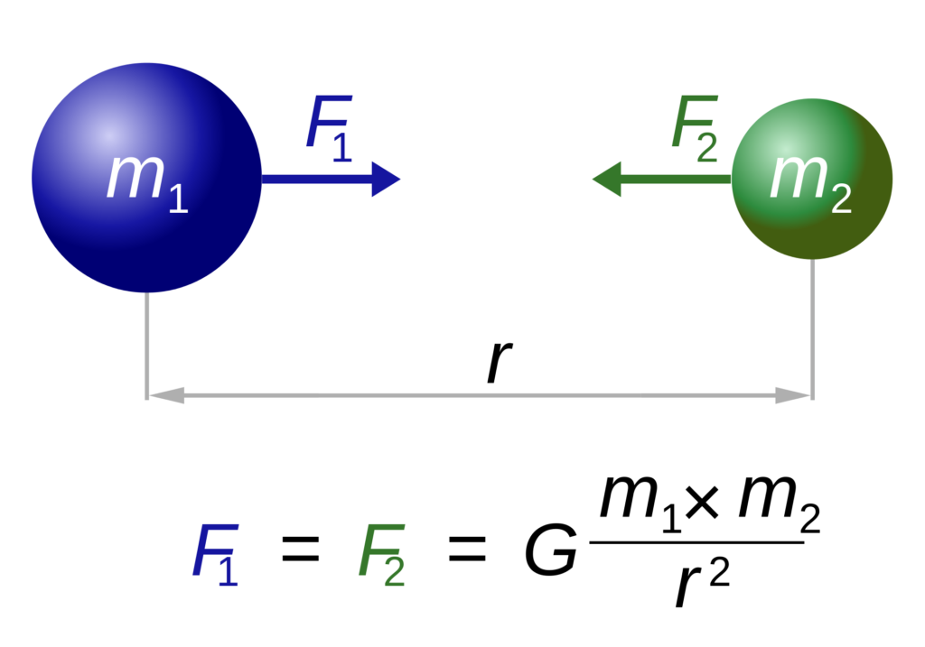
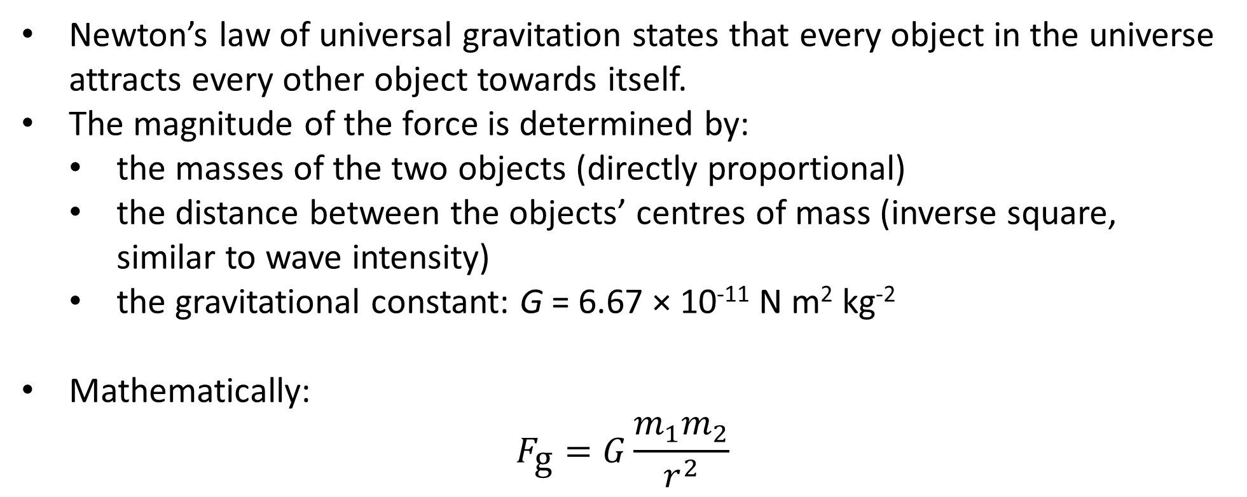
Newton’s Law of Universal Gravitation
Newton’s law of universal gravitation states that every object in the universe attracts every other object towards itself.
The magnitude of the force is determined by:
the masses of the two objects (directly proportional)
the distance between the objects’ centres of mass (inverse square, similar to wave intensity)
the gravitational constant: G = 6.67 × 10⁻¹¹ N m² kg⁻²
Mathematically:
$$F_{\text{g}}=G\frac{m_{1}m_{2}}{r^{2}}$$
Notes:
G is very small because gravity is very weak – for comparison, the strong nuclear force holding atoms together is about 10⁴⁰ times stronger (that’s 10 thousand billion billion billion billion)!
That’s not even the craziest thing about it though: if it were smaller or larger by an estimated one part in 10⁶⁰ of its current value, the universe would have either exploded too quickly for galaxies and stars to form, or collapsed back on itself too quickly for life to evolve.

Slide 3
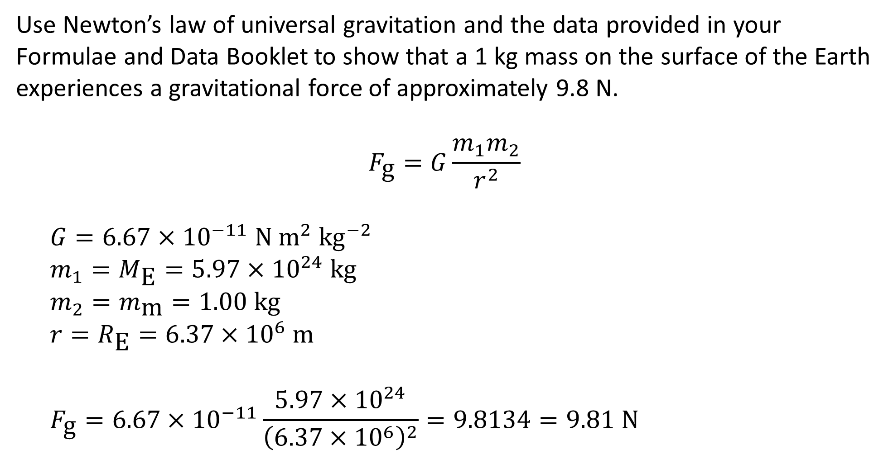
Example #1
Use Newton’s law of universal gravitation and the data provided in your Formulae and Data Booklet to show that a 1 kg mass on the surface of the Earth experiences a gravitational force of approximately 9.8 N.
$$F_{\text{g}}=G\frac{m_{1}m_{2}}{r^{2}}$$
$$G=6.67×{10}^{−11} \text{N} {\text{m}}^{2} {\text{kg}}^{−2}$$
$$m_{1}=M_{\text{E}}=5.97×{10}^{24} \text{kg}$$
$$m_{2}=m_{\text{m}}=1.00 \text{kg}$$
$$r=R_{\text{E}}=6.37×{10}^{6} \text{m}$$
$$F_{\text{g}}=6.67×{10}^{−11}\frac{5.97×{10}^{24}}{{\left(6.37×{10}^{6}\right)}^{2}}=9.8134=9.81 \text{N}$$
Notes:
Note that capital Ms and Rs are used for very larges masses and radii (e.g. those of planets)

Slide 4
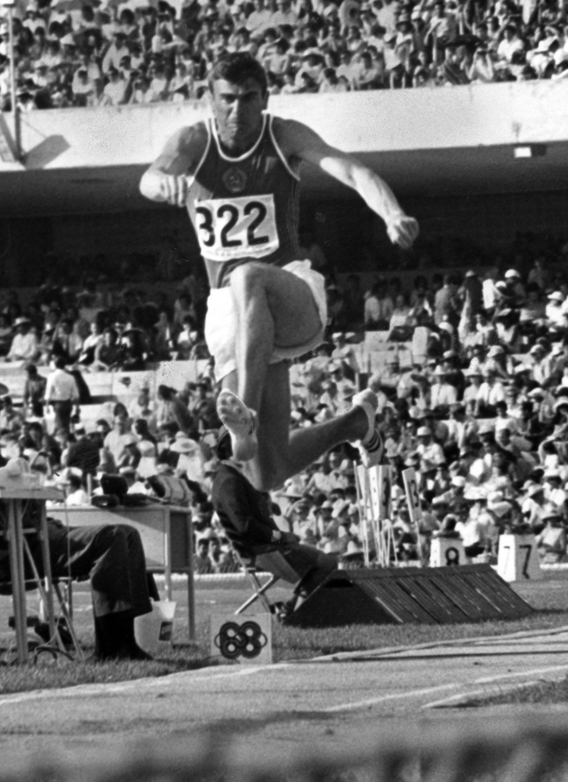
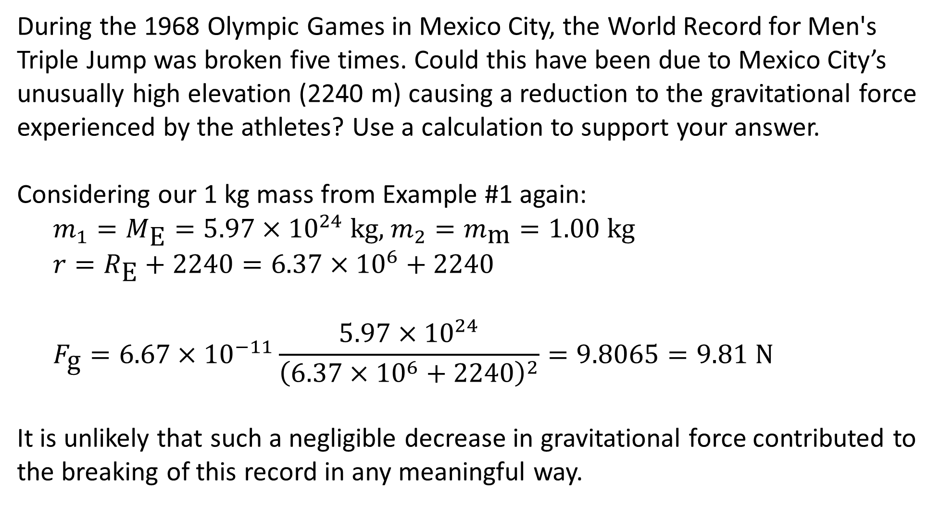
Example #2
During the 1968 Olympic Games in Mexico City, the World Record for Men's Triple Jump was broken five times. Could this have been due to Mexico City’s unusually high elevation (2240 m) causing a reduction to the gravitational force experienced by the athletes? Use a calculation to support your answer.
Considering our 1 kg mass from Example #1 again:
$$m_{1}=M_{\text{E}}=5.97×{10}^{24} \text{kg}\text{, }m_{2}=m_{\text{m}}=1.00 \text{kg}$$
$$r=R_{\text{E}}+2240=6.37×{10}^{6}+2240$$
$$F_{\text{g}}=6.67×{10}^{−11}\frac{5.97×{10}^{24}}{{\left(6.37×{10}^{6}+2240\right)}^{2}}=9.8065=9.81 \text{N}$$
It is unlikely that such a negligible decrease in gravitational force contributed to the breaking of this record in any meaningful way.

Slide 5
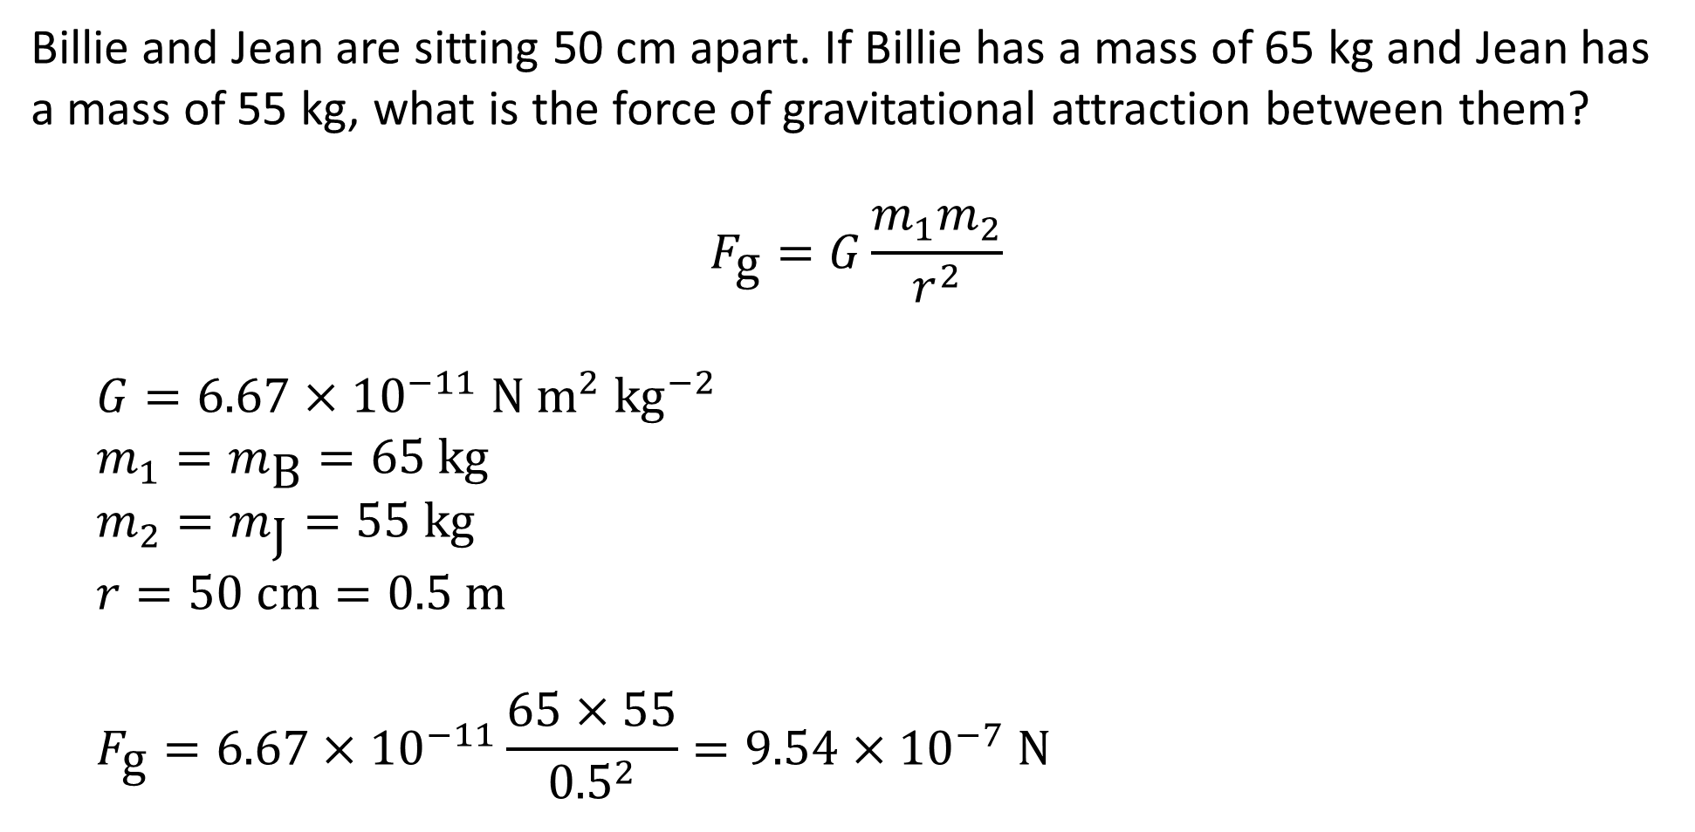
Example #3
Billie and Jean are sitting 50 cm apart. If Billie has a mass of 65 kg and Jean has a mass of 55 kg, what is the force of gravitational attraction between them?
$$F_{\text{g}}=G\frac{m_{1}m_{2}}{r^{2}}$$
$$G=6.67×{10}^{−11} \text{N} {\text{m}}^{2} {\text{kg}}^{−2}$$
$$m_{1}=m_{\text{B}}=65 \text{kg}$$
$$m_{2}=m_{\text{J}}=55 \text{kg}$$
$$r=50 \text{cm}=0.5 \text{m}$$
$$F_{\text{g}}=6.67×{10}^{−11}\frac{65×55}{{0.5}^{2}}=9.54×{10}^{−7} \text{N}$$
Notes:
The point being made here is that gravitational forces between everyday objects are so small that they are impossible to detect without highly specialised equipment, and so are usually considered negligible.

Slide 6
Gravitational Force
Unsurprisingly, gravity follows Newton’s third law of motion: when two objects interact, they apply forces to one another that are equal in magnitude and opposite in direction.
This means that as a planet pulls a moon, that moon is pulling the planet with the same amount of force. Because of this, both of the objects follow circular paths around a point between them called a barycentre.
The differences in mass mean that the acceleration produced by these forces differs greatly, but it’s enough to give the Earth a very slightly ‘wobbly’ orbit around the sun.
(Fun fact: the solar system as a whole has a barycentre – and it’s not the middle of the sun!)
Notes:
A barycentre is essentially the centre of mass of a two-body system.

Slide 7
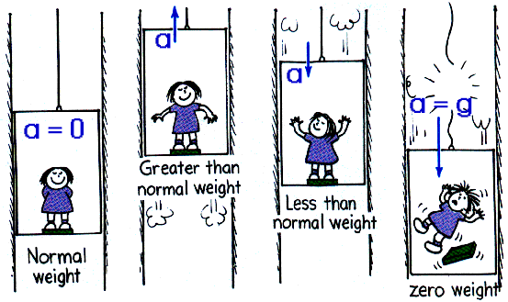
Apparent Weight
In physics, ‘weight’ is just another way of saying ‘gravitational force acting on an object’.
Interestingly, you never feel your own weight, since it is applied to the surface below you. Instead, you feel the upwards reaction force that the surface provides, which is usually equal to your weight.
In some situations, however, these two forces are not equal. In these cases the normal (usually upwards) force acting on you is referred to as your apparent weight.
This is most commonly observed when you are in an elevator that is speeding up or slowing down.
Notes:
Note that all uses of the word ‘weight’ in the picture should be replaced with ‘apparent weight’

Slide 8
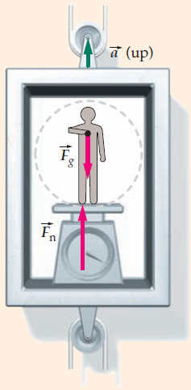
Apparent Weight
In an elevator that is accelerating upwards:
Your weight is unchanged and you are still standing on the floor, so you experience the same upwards reaction force that you always do.
However, since you are at rest relative to the elevator, you must be accelerating upwards at the same rate that it is. For this to occur, you must be experiencing an additional upwards force: the floor is pushing you up to match its acceleration.
Your apparent weight (the total normal force that you experience) is greater than it usually is, so you feel ‘heavier’.
Notes:
Note that ‘accelerating upwards’ can mean speeding up while going up or slowing down while going down.

Slide 9
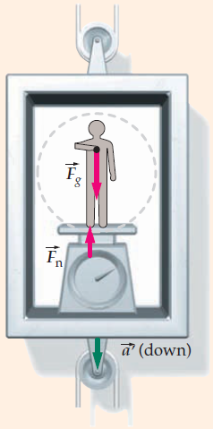
Apparent Weight
In an elevator that is accelerating downwards:
Unlike the previous situation, the elevator does not apply an additional force to your body: instead, you are accelerated downwards by part of your own weight.
The size of this ‘part’ is determined by the elevator’s rate of acceleration, which you match (F = ma).
Your remaining weight is applied to the floor of the elevator, which provides a reaction force.
Your apparent weight (the total normal force that you experience) is less than it usually is, so you feel ‘lighter’.
Notes:
Note that ‘accelerating downwards’ can mean speeding up while going down or slowing down while going up.
Taking this situation to its extreme helps to explain why you feel ‘weightless’ while in freefall – you’re not experiencing any normal force, so your apparent weight is 0 even though your actual weight is unchanged.

Slide 10
Example #4
A 79.0 kg student rides a lift up to the top floor of an office block. During the journey, the lift accelerates upwards at 1.26 m s⁻² before travelling at a constant velocity of 3.78 m s⁻¹ and the finally decelerating at 1.89 m s⁻².
Calculate the apparent weight of the student in the first part of the journey (accelerating upwards).
Calculate the apparent weight of the student in the second part of the journey (constant velocity).
Calculate the apparent weight of the student in the final part of the journey (decelerating).

Slide 11
Example #5
According to a popular urban myth, you can survive in a falling elevator by jumping the moment before impact. Explain:
why this is untrue
why you wouldn’t be able to jump as well as you normally can in this situation
Notes:
“The urban myth is patently false. It is like suggesting that a pedestrian could survive a head-on collision with a truck at 45 m/s by walking backwards from it just before impact.”

Slide 12
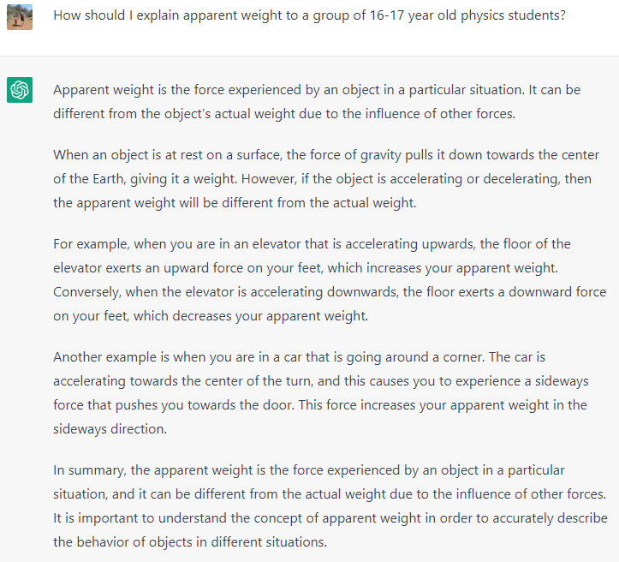
Bonus Question
When asked to explain apparent weight, ChatGPT produced this. Can you find the two errors holding it back from taking my job?

